Slide 1





Advanced
Robotic Process Automation
Automated Invoice Processing System
Your Register No : 220701072
Your Name : ESPIN SHALO S P
Guide Name : DURAIMURUGAN N
Designation and Department : Assistant Professor , Computer Science and Engineering

Slide 2
Abstract
The proposed project, “Automated Invoice Processing System using UiPath REFramework,” focuses on automating the repetitive and error-prone task of invoice data entry. The system extracts essential details such as invoice number, vendor name, date, and amount from PDF/Excel invoices and validates them against predefined business rules. Using UiPath’s Robotic Enterprise Framework, the solution ensures transaction-based processing, centralized exception handling, logging, and scalability. This automation reduces manual effort, improves accuracy, minimizes processing time, and provides end-to-end transparency in invoice handling..

Slide 3
Need for the Proposed System
Manual invoice entry is time-consuming and prone to human error.
Growing number of invoices increases workload on finance teams.
Delays in invoice processing can affect vendor relationships and payment cycles.
Existing systems lack scalability and robust error handling.
A structured RPA solution with REFramework ensures reliability, scalability, and better process control.

Slide 4
Advantages of the Proposed System
Faster invoice processing with reduced turnaround time.
Improved accuracy by eliminating human errors.
Centralized logging and reporting for better auditability.
Robust exception handling for both business and system errors.
Easy to scale with UiPath Orchestrator queues.

Slide 5
Literature Survey
Paper 1: “Research and Application of Robotic Process Automation in Financial Services” – IEEE Xplore
Advantages: Demonstrates how RPA can automate repetitive finance operations such as invoice entry, reconciliation, and report generation. Provides improved accuracy, reduced human effort, and faster turnaround time.
Disadvantages: Limited discussion on robust error handling and scalability when processing bulk financial data.
Paper 2: “Robotic Enterprise Framework for Transaction-Based Automation” – IEEE Conference Paper
Advantages: Highlights the strength of REFramework in handling large-scale transactional processes like invoice processing. Built-in exception handling, retry mechanisms, logging, and queue management make it reliable for enterprise use.
Disadvantages: Initial setup complexity is higher compared to linear workflows, requiring more design effort and configuration.

Slide 6
Main Objective
Hardware:
Processor: Intel i5 or above
RAM: 8 GB minimum
Storage: 256 GB SSD
Software:
UiPath Studio
UiPath Orchestrator
MS Excel
Windows 10/11

Slide 7
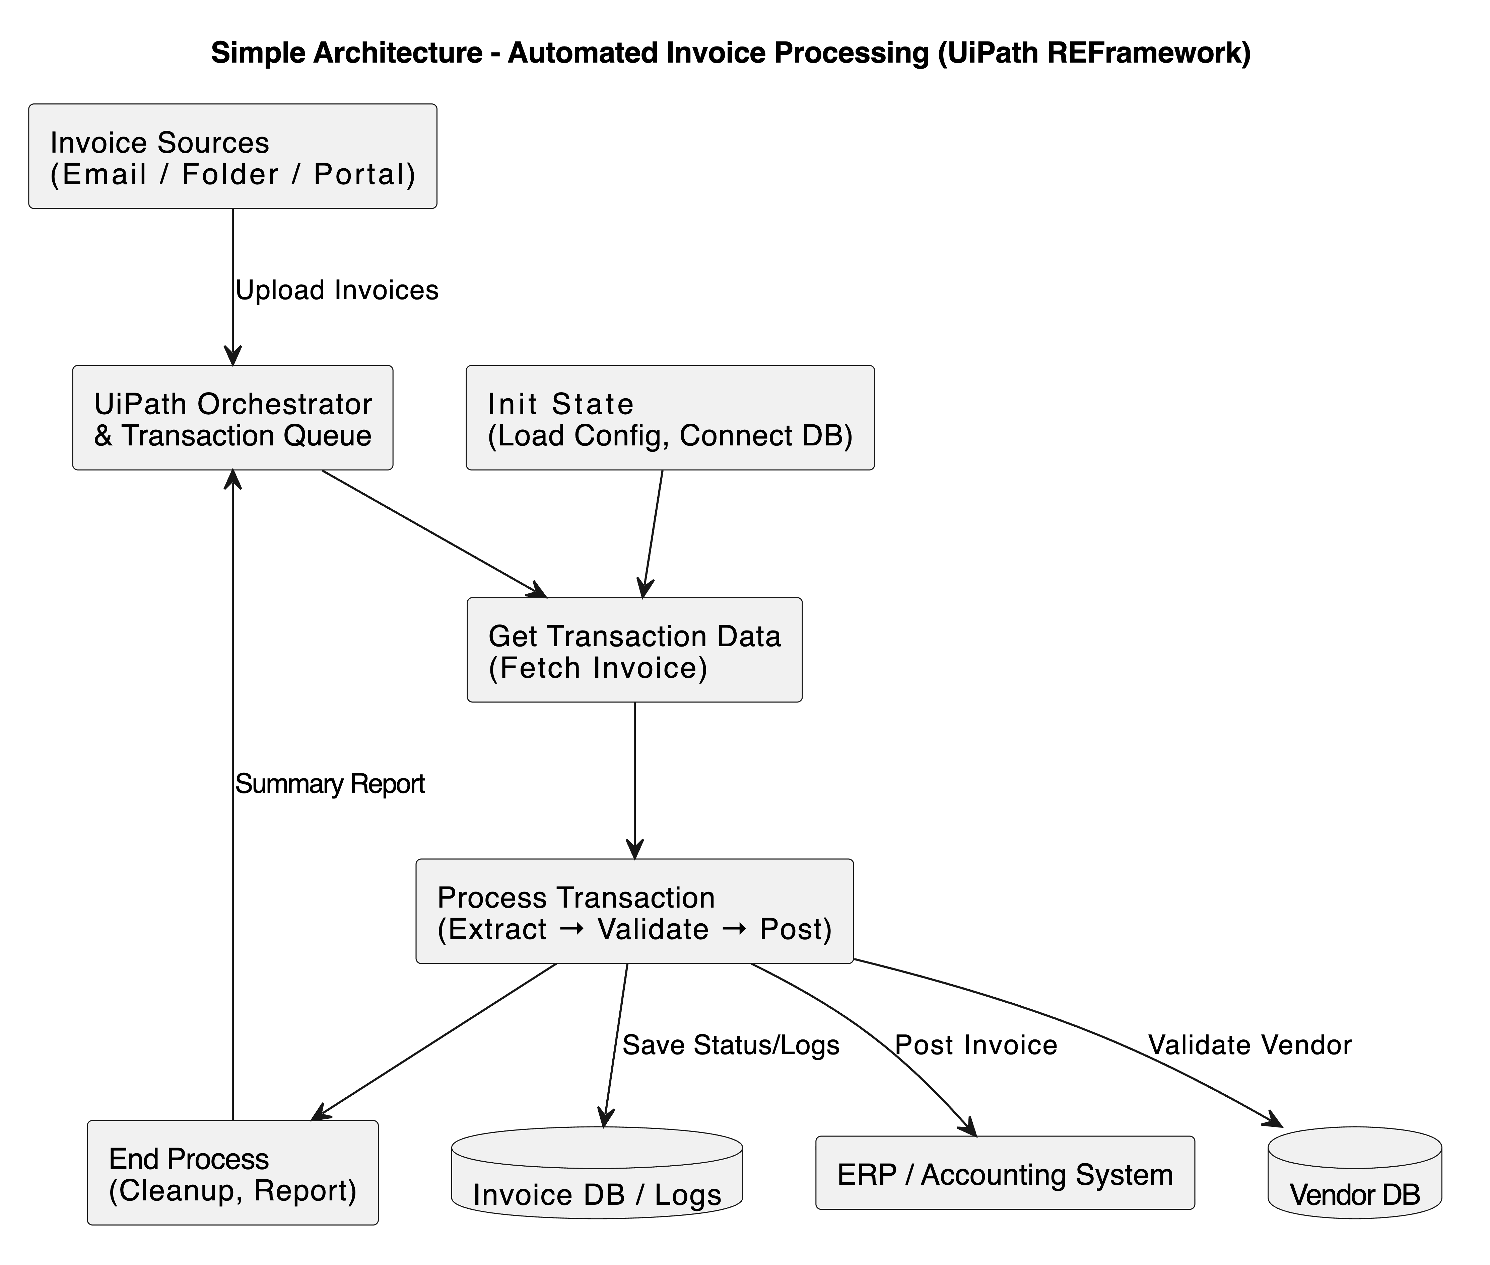
Architecture

Slide 8
System Requirements
Hardware:
Processor: Intel i5 or above
RAM: 8 GB minimum
Storage: 256 GB SSD
Software:
UiPath Studio
UiPath Orchestrator
MS Excel
Windows 10/11

Slide 9
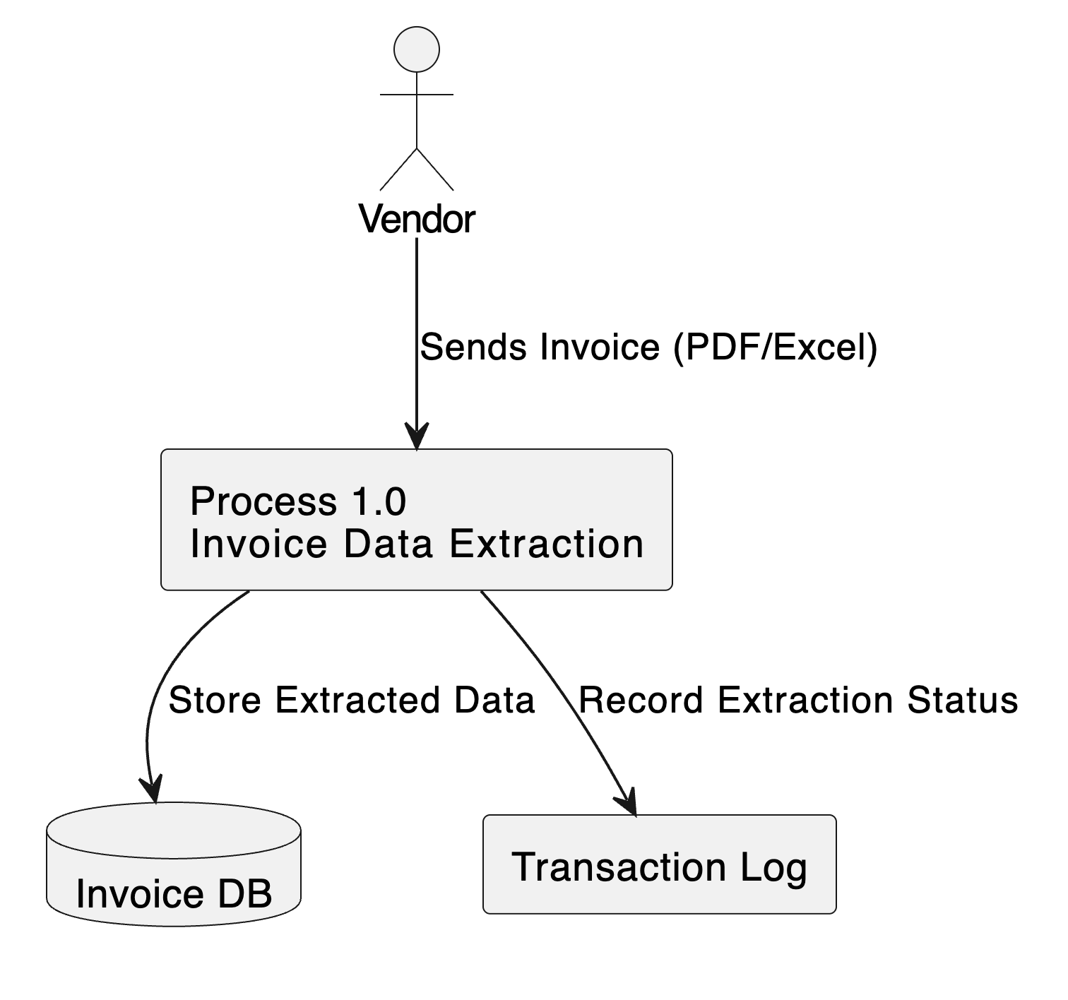
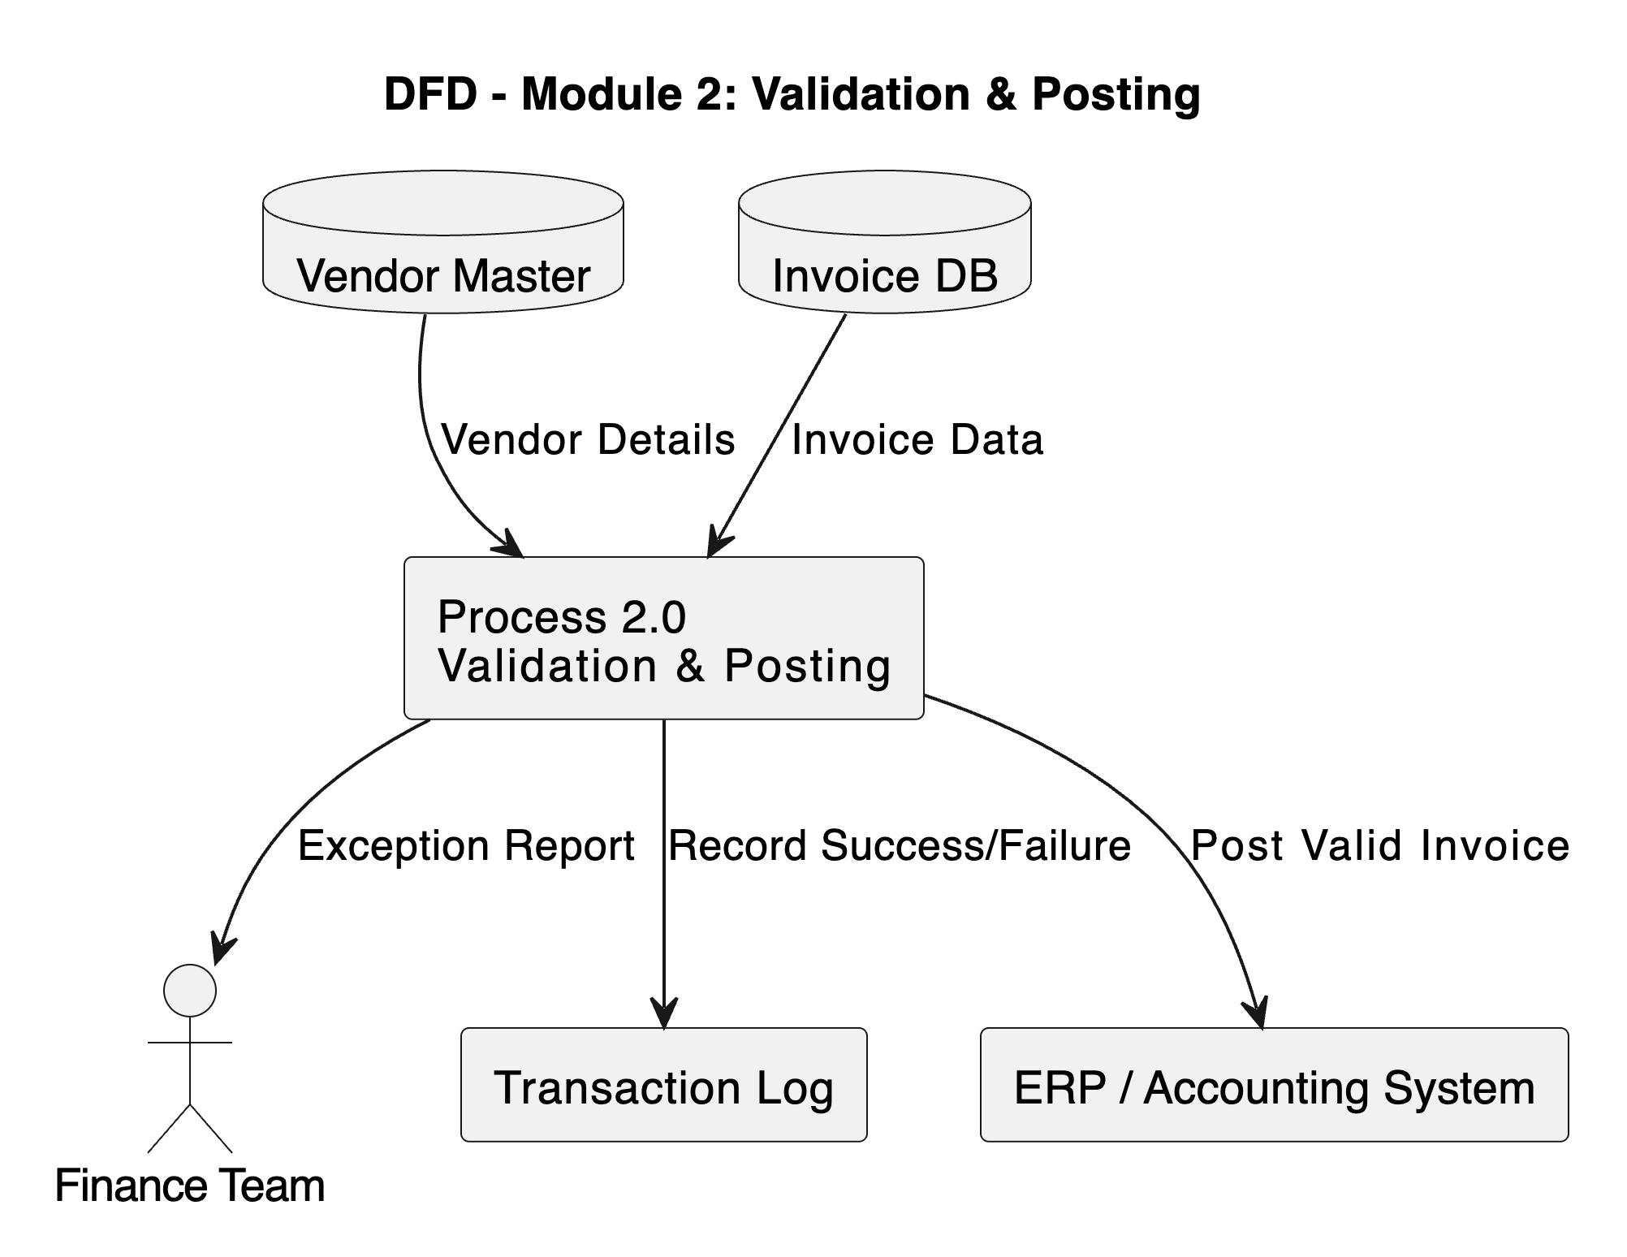
Functional Description
Module 1: Invoice Data Extraction
Reads invoice files from folder/email.
Extracts fields using UiPath PDF/Excel activities
.
Module 2: Validation & Posting
Validates data against master records.
Posts invoice into ERP system.
Updates status in transaction log.

Slide 10
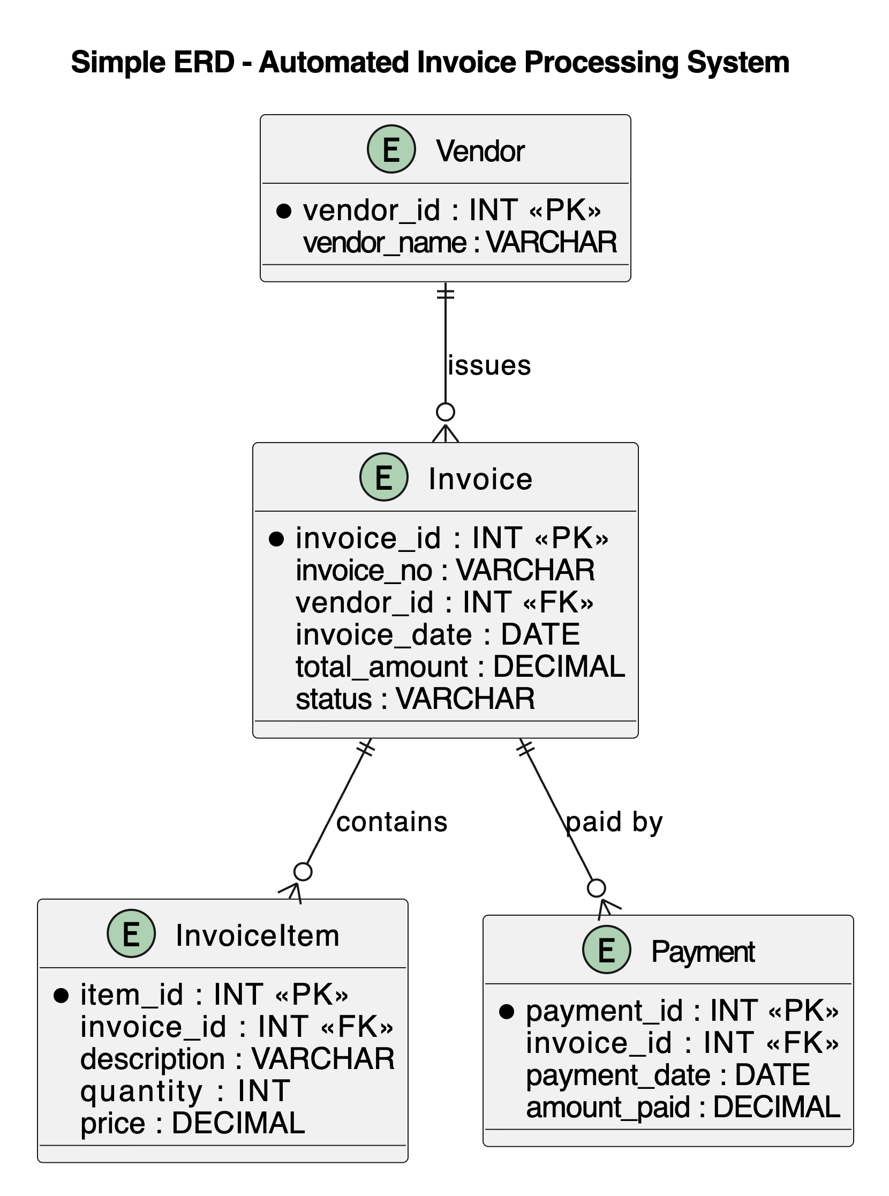
Table Design

Slide 11
Process Design
Main Process: End-to-end invoice automation. Sub Process:
Data extraction
Validation
Posting
Logging & Exception Handling

Slide 12
Conclusions
The project successfully automates the end-to-end invoice processing workflow using UiPath REFramework.
Manual, error-prone, and time-consuming invoice entry is replaced with a scalable and reliable RPA solution.
The use of REFramework ensures robust exception handling, transaction-level processing, and detailed logging.
The system improves processing speed, accuracy, and transparency, reducing operational costs and manual workload.
Overall, the solution demonstrates how RPA with REFramework can transform finance operations into a streamlined, efficient, and error-free process.

Slide 13
Future Enhancement
Integration with more ERP systems.
Multi-language invoice support.
Analytics dashboard for invoice trends and insights.

Slide 14
IEEE Paper
“Automating the Audit of Electronic Invoices with a Soft Robot,” Tian Jun Cheng, Chia Jung Chen, Yao Lin Ong, Yi Fang Yang, Guang Yih Sheu, 2024 — describes using RPA bots to download e-invoice data from cloud, compare with on-prem records, and flag inconsistencies automatically.
“Integrated Invoicing Solution: A Robotic Process Automation with AI and OCR Approach”, Norashikin M. Thamrin et al., 2022 IEEE 20th Student Conference on Research and Development (SCOReD) — proposes a system combining RPA + OCR/AI to extract invoice data and post into accounting applications.
“Automating the Audit of Electronic Invoices with a Soft Robot”, Tian Jun Cheng, Chia Jung Chen, Yao Lin Ong, Yi Fang Yang, Guang Yih Sheu, 2024 — describes how a bot downloads e-invoice data, compares with on-prem records and flags inconsistencies, reducing audit effort.

Slide 15
References
Cheng, Tian Jun; Chen, Chia Jung; Ong, Yao Lin; Yang, Yi Fang; Sheu, Guang Yih. “Automating the Audit of Electronic Invoices with a Soft Robot,” 2024.
Nur Ashikin Rohaime, Norashikin M. Thamrin, Nur Idora Abdul Razak, Chua Wei Shyan. “Integrated Invoicing Solution: A Robotic Process Automation with AI and OCR Approach,” 2022 IEEE SCOReD Conference

Slide 16
Thank You…!

